Slide 1
Magic 8-Ball:
Using Chat GPT
Team 6
https://github.com/cse110-sp23-group6/8-ball.git

Slide 2

Table of Contents:
Project Overview
Improvements
Chat GPT Analysis
Insight
Final Remarks

Slide 3

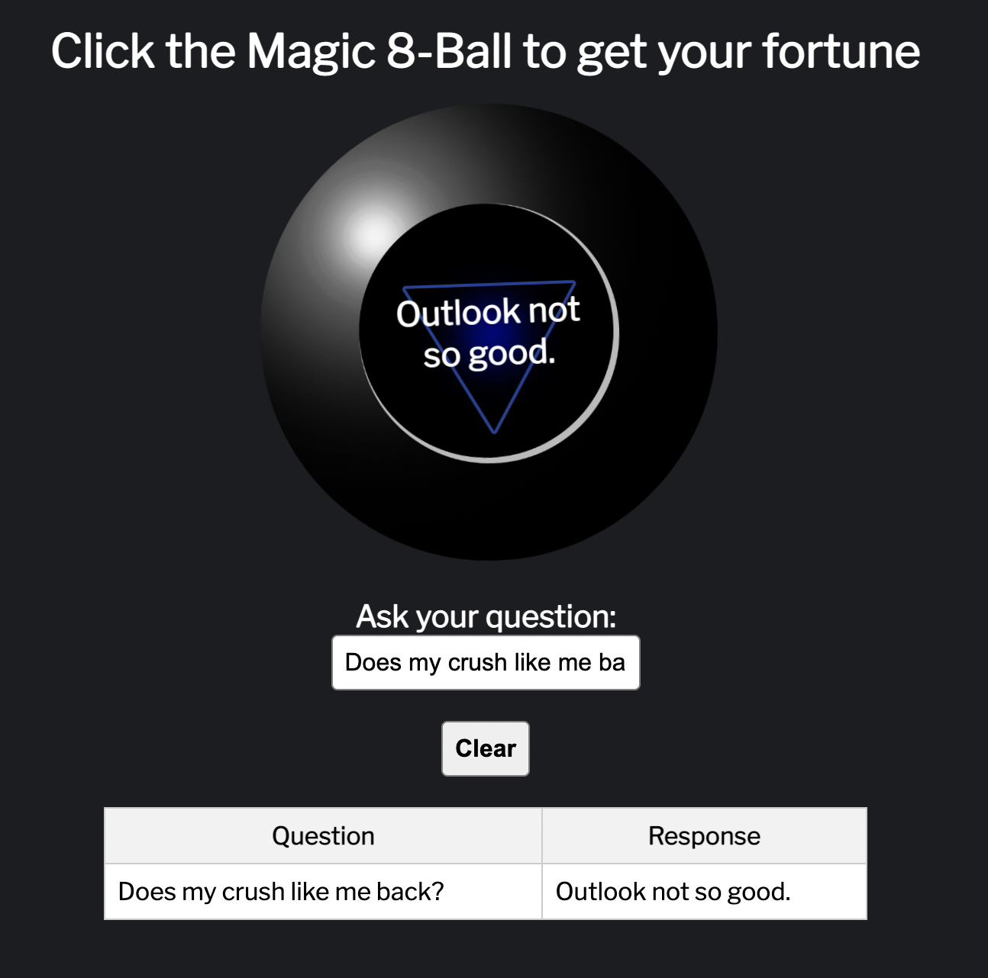
Overview: App
Write your question
Click the 8-ball
Get a peek into the future by the all-powerful Magic 8-ball created by the “Sixth Sense”
Your previous answers are recorded in the table below
You can clear the table using the clear button

Slide 4

Overview: Creation Process
Provide Chat-GPT with a prompt to create an 8-ball app.
Copy the code to Replit and to try it out.
Find places for potential features / improvements (+ receive feedback from teammates)
Provide Chat-GPT with a prompt to create the features / improvements from step 3.
Repeat steps 2 - 4.
Add manual improvements and comments as needed.
App created!
Notes:
Maybe add a few screenshots

Slide 5

Improvements: Prompts
While creating the app, we could not rely entirely on Chat GPT. Here are a list of the additional prompts we had to give to the generative AI.
Additional Prompts:
Display questions and answers in a table.
Add a clear button for user input.
Display answers on the image of an 8-ball.
Make the ball move as if it is being shaken.
Make test cases.

Slide 6
Improvements: Manual
We also had to go in manually and make a few changes, when Chat GPT did not seem to understand exactly what we wanted from the prompts. Such changes are listed below.
Manual Changes:
Change the text color and background color so that the text is visible.
Add comments to the code files to improve readability.
Adding the background and two sound files which merge to produce a drum roll.
Adding test cases using Jest package and using Puppeteer js.
Storing the past responses in the browser using local storage.

Slide 7

Chat GPT: Positives
Speed
2. Setup
Time it took to create the app was a bit faster than coding manually.
Took 1 hour to create the initial version of the working app.
Useful in creating a basic framework for the app.
Was able to make a crude draft of the final app.
Gives a good place to start.

Slide 8

Chat GPT: Negatives
Sometimes Chat GPT breaks down completely and outputs nonsense.
Need human intelligence to realize output is wrong.
When there is significant amount of previous work, Chat GPT loses track of memory from the very beginning.
Hard to create the exact prompt you want without having to restate things that were already prompted earlier.
No comments.
Basic file names are confusing.
Errors with tabing and alignment.
Text and background can come in the same color, making it hard for users to read.
Need knowledge of coding language to fix these issues.
Nonsense
2. Small Memory
3. Readability

Slide 9
Chat GPT: Potential Improvements
Testing basic functionality
Descriptive Comments
Create potential test cases after generating code to check if the code is working properly.
Generates test cases not related to the 8-ball it self.
Not great at testing specific 8-ball tests like shaking and ‘Clear History’ button.

Slide 10

Insight & Takeaways:
Generative AI only serves as a framework or starting point for creating a certain app or project.
Initially, the project looks to work but upon further inspection, the errors made by Chat GPT are evident.
Gets frustrating to work with when it forgets the prompts you gave it before, and then you need to ask for the same requirements again.
Highly unreliable!
Because of this, it is important to have knowledge of the programming language so that you can manually go in and fix them.
User friendly code can not be generated well by Chat GPT. We had to add comments, proper documentation, and improve readability.

Slide 11

Final Remarks:
How can Chat GPT aid us in future programming projects?
Can still use to get a basic idea / first draft of the project.
Need substantial manual changes and further prompting to get to a workable copy of projects.
Still necessary to have knowledge of the language being used so mistakes can be corrected.
Need to manually test extensively, as Chat GPT is error prone and not perfect.

Slide 12

Thank You!
Development Team: Amit, Brian, Vasil
Presentation: Prisha, Haven, Bao
Documentation: Jose, Bao, Wilson
Video: Haven

